Slide 1


micro:bit entry video tutorial
Lesson 11
micro:bit sensor lesson 11 “A coward”
YahBoom micro:bit module tutorial

Slide 2
micro:bit entry video tutorial
Content
Part1
Part 2
Part3
Part 4
Part 5
Learning goals
Preparation
Connection
Search for blocks
Combine blocks
YahBoom micro:bit module tutorial

Slide 3
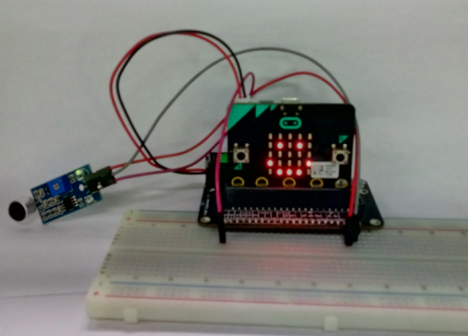
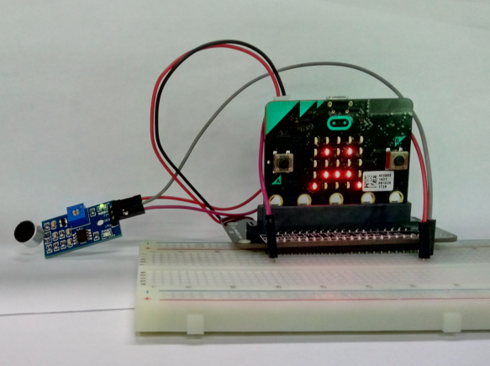
micro:bit entry video tutorial
Part 1
Learning goals
Hello, I'm micro:bit. I'm a coward. I'm always smiling like the first picture. If you talk to me loudly, I'll be scared into second pictures.
Do you want to make a coward with micro:bit? Follow me.
YahBoom micro:bit module tutorial

Slide 4
micro:bit entry video tutorial
Part 2
Hardware:
● 1 X Micro: bit Board
● 1 X Micro:bit breakout
● 1 X 830 holes breadboard
● 1 X Micro USB Cable
● 3 X Female to male cable
● 1 X Sound sensor
Preparation
Then the micro:bit is connected to the computer through USB, and the computer will pop up a U disk and click the URL in the U disk to enter the programming interface. Input this URL https://github.com/lzty634158/yahboom_mbit_en to get the package.
YahBoom micro:bit module tutorial

Slide 5
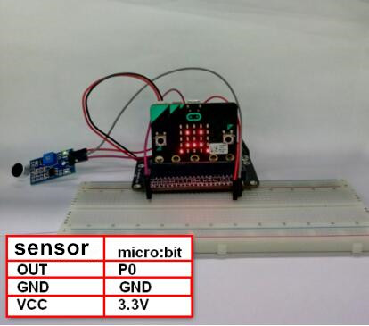
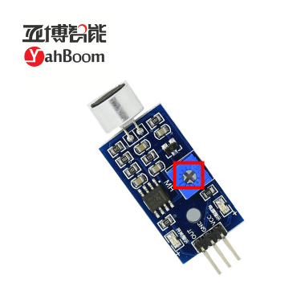
micro:bit entry video tutorial
Part 2
Connection
You can connect the cable according to the connection table above.A sound sensor needs to be debugged before use, and a screwdriver is needed to adjust the sensitivity of the sound sensor (a ring of small circles around). The lattice has always been a smiling face or a dot matrix and often turns into a crying face because the sensitivity is not well adjusted.
YahBoom micro:bit module tutorial

Slide 6
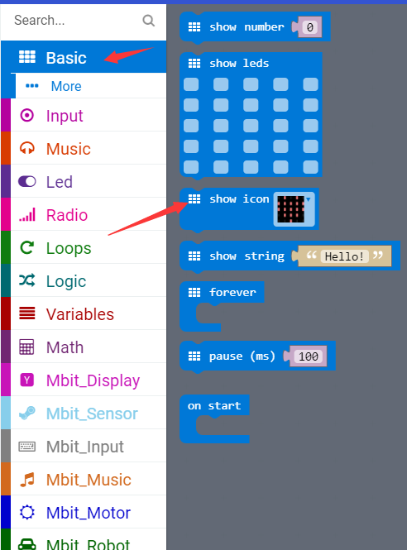
micro:bit entry video tutorial
Part 3
Search for blocks
YahBoom micro:bit module tutorial

Slide 7
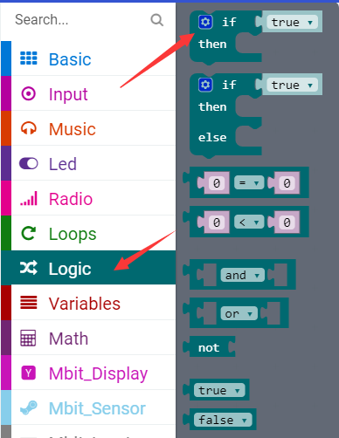
micro:bit entry video tutorial
Part 3
Search for blocks
YahBoom micro:bit module tutorial

Slide 8
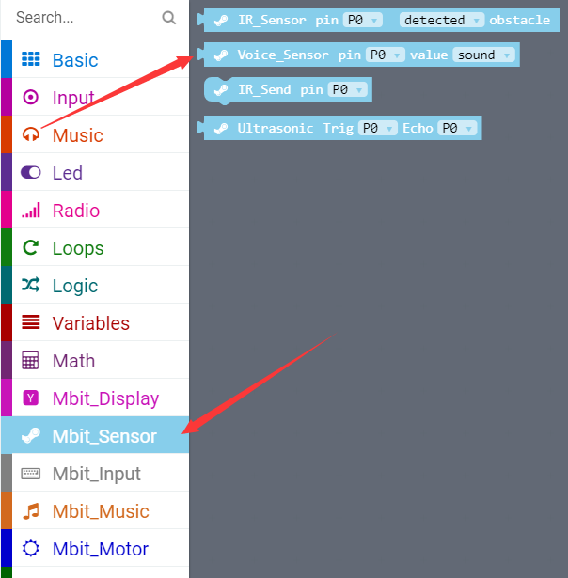
micro:bit entry video tutorial
Part 3
Search for blocks
YahBoom micro:bit module tutorial

Slide 9
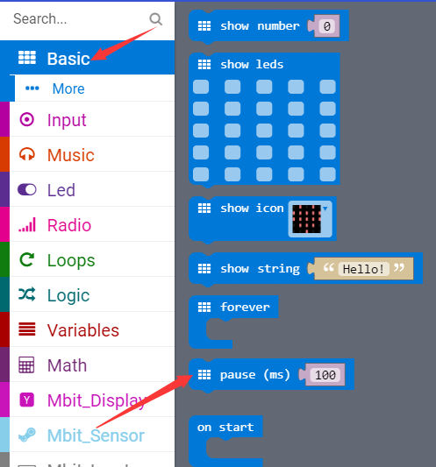
micro:bit entry video tutorial
Part 3
Search for blocks
寻找积木
YahBoom micro:bit module tutorial

Slide 10
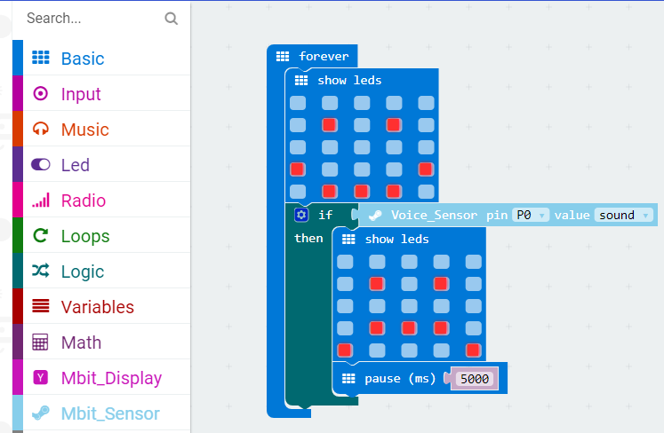
micro:bit entry video tutorial
Part 4
Combine blocks
YahBoom micro:bit module tutorial

Slide 11
micro:bit entry video tutorial
micro:bit
project
Thanks for watching！
Powered by YahBoom
YahBoom micro:bit module tutorial

